Slide 1


Emerging Technologies & Regulation
Thursday 23 November 2023
AI & The Future of Regulation Symposium
Queen’s University Belfast
Pavle Avramovic, Manager, Emerging Tech and Research, Innovation Department

Slide 2


Contents
Why Should Regulators Engage with Innovation and Emerging Technologies?
-
Introduction to Innovation
-
Horizon Scanning Framework
-
Areas of Focus & Case Studies
-
What Does The Future Hold?
2

Slide 3

The purpose of looking at the future is to disturb the present.
Gaston Berger
3
Notes:
What does this quote mean to you? Open and stimulate discussion

Slide 4





Why should regulators engage with innovation?
Improving Competition
Creating an innovative environment could increase competition and lead to better consumer choice​
Strategic Foresight​
A deeper understanding of technology and its market implications can enable a more 'future-proof' perspective ​
Opportunity and Risk Identification​
Higher exposure to innovation can lead to being better equipped to spot opportunities and risks ​
Self-Innovation​
Regulators can benefit from applying these new insights into developing and implementing new technological solutions​
4

Slide 5

FCA Innovation Department
The FCA’s Innovation department has three core roles:
1
Help firms with innovative business models to operate and develop in the regulatory context.
2
Support the FCA to sustain a regulatory environment that facilitates innovation but is aware of the potential harm it poses.
3
Engage and influence at both a national and international level to further promote innovation in the interest of consumers.

Slide 6
FCA Innovation Services
Emerging Tech & Research
Identify and raising awareness of emerging trends in technology and sharing insights on their potential impacts.
Change & Development
Continuously assess our services and work programme and identify opportunities for improvement
TechSprints Convening stakeholders from across and outside financial services to develop technology-based ideas and prototypes to address specific industry challenges.
Digital Sandbox
Aims to support and accelerate earlier stage innovation where products and solutions are still in development and not ready for testing on consumers or in a live environment.
Innovation Pathways Provides support to firms who want swift, tailored regulatory feedback and guidance on how the FCA’s regulatory regime applies to their specific business model.
Regulatory Sandbox
Allows businesses to test eligible and desirable innovative propositions in the market with real consumers.
Cross-border Testing (GFIN)
Supporting scale testing of financial products, services, business models and RegTech in more than one country or jurisdiction.
AI Team
Develop and inform strategy and policy thinking regarding Artificial Intelligence in Financial Services
Cooperation Agreements
Supporting innovators to explore and enter other markets through referral and engagement with international peers.
9/4/20XX
Pilot and prototyping
Diffusion and scaling
Idea generation and development
Pilot and prototyping

Slide 7



The Emerging Tech & Research Team​
Deliver insight, thought leadership and education to enable the gold standard of regulatory innovation
Vision
Objectives
Research
Collaboration
Education
Provide insights on how emerging technology trends could impact financial services markets, firms, consumers and regulators to inform strategy setting and policy thinking
Collaborate and influence the early development of technologies through thought leadership to shape digital markets and facilitate beneficial innovation in the interest of consumers
Educate and provide knowledge to FCA colleagues and broader regulatory ecosystem on emerging technology and their implications to support a proactive approach to regulation
Examples: Horizon Scanning Report, Web3 Insight Paper, Synthetic Data Feedback Statement
Examples: DRCF horizon scanning & SDEG launch
Examples: On the Horizon & the TechKnow Series
7

Slide 8

Primary Focus Area
Technologies of interest
Quantum Technologies
DeFi:
Price Oracles & Maximal Extractable Value
Immersive Technologies Business Models
Futures & Foresight Pilot
Synthetic Data & Privacy Enhancing Technologies
Evolutions of Digital Identity
Our Work Programme
Primary Focus Area
Primary Focus Area
We use a formal Horizon Scanning process to identify technologies of interest. Our current focus areas are:
Examples of our research questions:
What are the market participants’ perspectives on different behaviours within DeFI?
What is the role of synthetic data for driving innovation in financial services?
What are the regulatory implications to market integrity of novel activities in DeFi?
What are the impacts of quantum technologies on financial services markets, consumers and regulators?
Future Focus
DRCF Focus Area
8
DRCF Focus Area

Slide 9

Horizon Scanning & EmTech

Slide 10





Horizon Scanning – How it Works?
Desk-based research and external engagement with academia, technology firms, international regulators, financial services firms and other bodies
1
Desk research
Evidence gathering and analysis of findings to support identified trends and observations
2
Evolving and uncertain
external world
3
Inform organisational thinking & prioritisation and establishment of collaborative projects internally, with industry and with the academic community
External engagement
Evidence gathering
Inform FCA thinking
Findings analysis
Outcome
Evidence-informed FCA initiatives
Collaborative projects
10
Notes:
Here we have an example of our horizon scanning process and the different steps that are entailed within it
Standardised based on futures techniques and learnings we can gather from industry and other regualtors

Slide 11
5 D Methodology
There are 5 dimensions to our Horizon Scanning focus across innovation in financial services with a two-fold lens:
EmergingTech
The use of emerging technologies and systems by financial services firms e.g., Quantum Computing
FinTech
Technologies & systems used for the provision of Financial Services and products e.g., crypto, AI in FS, Open Finance
SupTech
Novel technologies and systems used by regulators to support the regulatory process e.g., Prudential Monitoring Solutions
RegTech
Technologies & systems used by firms to support risk and compliance e.g., KYC, Regulatory Reporting
BigTech
BigTech firms’ (Microsoft/Amazon/Google etc.) activities in Financial Services e.g., WhatsApp Pay, Novi
Proactive vs Reactive
Current State vs Future State
11
11
Notes:
An important way we keep abreast of technological and innovation developments is through our horizon-scanning work.
There are 5 areas or ‘Dimensions’ that this work covers, looking through both a current and future state lens.
Today we will focus on EmergingTech, but worth acknowledging different areas and the potential overlaps between them
The five areas are FinTech for example crypto, Artificial Intelligence in Financial Services; RegTech including compliance enhancing technologies to support KYC and regulatory reporting; Emerging Tech such as quantum computing; SupTech which are technologies used by regulators to support their regulatory process and finally BigTech solutions and new financial offerings by BigTech firms.
We have both proactive and reactive elements to this work. Proactive – we look at nascent areas that are yet to or have had limited interaction with financial services
And Reactive - areas that are already being actively explored within the organisation, where we support colleagues with our research methods and insights brought through our external engagement with financial services firms, academics and innovators
We also look at these issues in terms of their lifecycle - so their current state of play to understand where things are - which also provides a good reference point to understand their potential trajectory in terms of what the future state might look like.
As with all frameworks, we go through iterations, but through our work programme we have developed evidence that this captures the landscape well

Slide 12
Synthetic Data
Focus

Slide 13
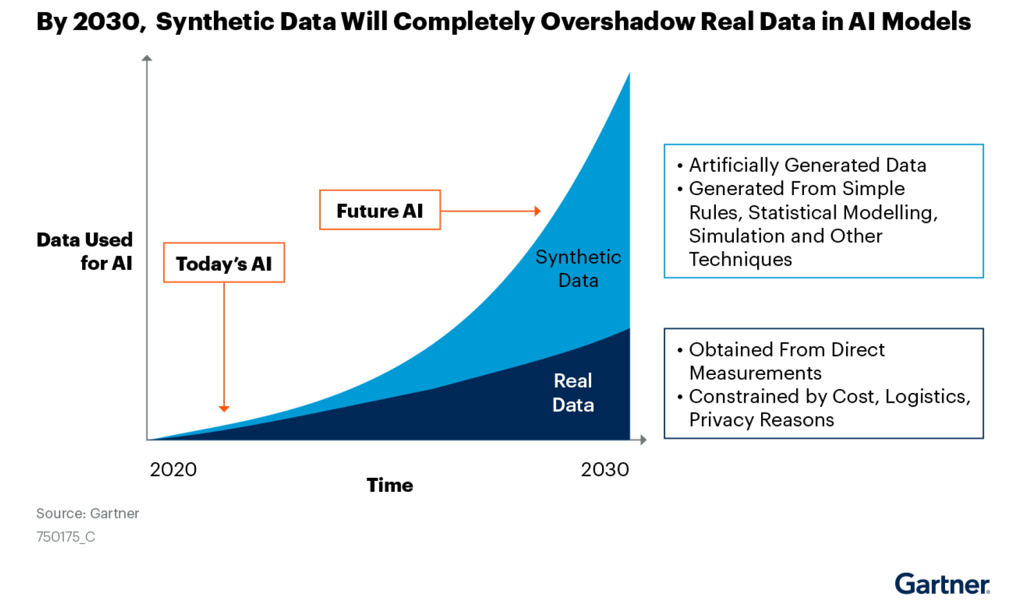
What is synthetic data?
Synthetic data is ‘fake data’ that uses ‘algorithms to generate data that preserves the original data’s statistical features while producing entirely new data points.’ (Alan Turing Institute)
Synthetic data sits within a broader range of Privacy Enhancing Technologies (PETs) which ‘can help organisations share and use people’s data responsibly, lawfully, and securely, including by minimising the amount of data used and by encrypting or anonymising personal information’. (Information Commissioner’s Office)
Notes:
Pavle

Slide 14
Why synthetic data and PETs?
High quality data is increasingly driving innovation in financial services, for example advances in AI and machine learning models.
In the UK, GDPR and the Data Protection Act place conditions on sharing data within and across organisations, to protect consumers’ right to privacy.
The opportunity
The caveat
Through our synthetic data and PETs programmes, we are looking to address 2 problem statements:
1
How might we encourage the adoption of synthetic data and PETs to enable privacy-secure data sharing, and therefore innovation, in UK financial markets?
How might we leverage synthetic data and PETs internally to augment our own regulatory capabilities?
2
Notes:
Why are we interested in synthetic data?
In the Innovation department, we’re particularly interested in driving innovation in financial services, and we know from research that high quality data is a key enabler to innovation
However, data quality issues, legacy systems and lack of clarity around data protection regulations is limiting data sharing and access in financial services, particularly for new market entrants
When we started our synthetic data journey, we were interested in the first use case …
As time has gone on, we have started testing this technology to meet regulatory/supervisory use cases, to understand whether and how we can use this technology to meet our regulatory objectives

Slide 15







Overview of external FCA synthetic data work programme
The synthetic data initiatives aim to explore how technology can enable privacy compliant data sharing in financial services to drive innovation in the interest of consumers and promote competition. We aim to have a balanced approach between research & practical efforts.
Industry Call for Input
Development of Synthetic Data
Important industry insights on how to evolve the work programme
Report on best practice & use cases to advance industry adoption, and regulatory insights
Ongoing Research
Active research with expert academics and industry on addressing key challenges in Synthetic Data
Hosting & Iteration of Datasets
Host data sets in sandbox and make it available for select firms
Industry Call For Input
Synthetic Data Expert Group
Enable Collaboration
Establishment of the SDEG to collaboratively progress the discussion on how to responsibly innovate with synthetic data
Framework to be created and implemented within Digital Sandbox to advance data collaborations in industry
Research & Engagement
Digital Sandbox & TechSprints
Advance research and collaborate with experts to identify and share best practice
Support innovation and competition, understand and manage emerging tech risks at technical level.
Notes:
Call for Input published in May 2022.
Responses showed demand for synthetic payments data, with financial crime a key use case.
Firms can access it to develop automated transactions monitoring systems.

Slide 16



Synthetic Data Expert Group Update
The SDEG was set-up in response to the Call for Input which highlighted the FCA’s important role as an industry convener.
The FCA has created the SDEG to help address two problem statements:
1
2
How might we encourage the adoption of synthetic data and PETs to enable privacy-secure data sharing, and therefore innovation, in UK financial markets?
How might we leverage synthetic data and PETs internally to augment our own regulatory capabilities?
Output 1: Using synthetic data in FS report
Publication of a report outlining how synthetic data can be applied to a range of uses cases across FS, including fraud, credit scoring, open banking and AML controls. Published in Q1 2024.
Output 2: Collaboration framework
Create an effective framework for collaboration across industry, regulators, academia on issues related to synthetic data. Delivered by Nov 2024.
Optional extension to test framework in digital sandbox (November 2024 onwards)
16

Slide 17
Digital Regulation Cooperation Forum
Horizon Scanning

Slide 18
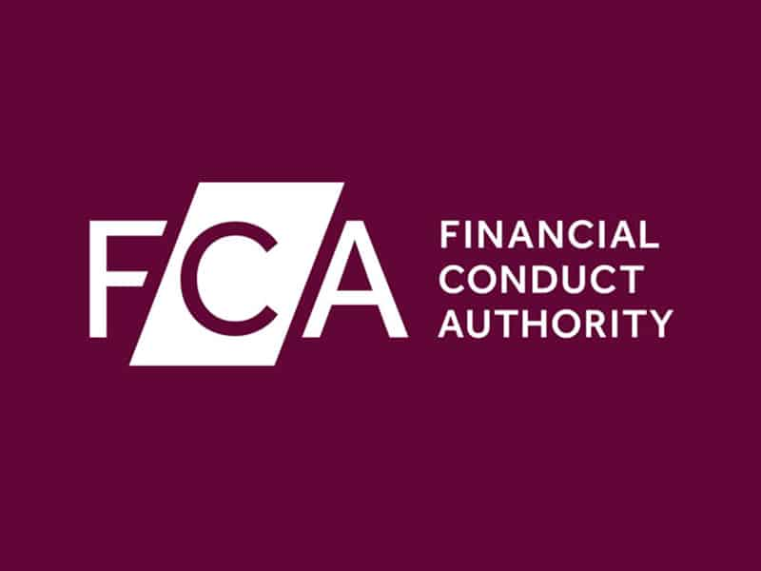



Enabling cross-regulatory horizon scanning: DRCF
Digital Regulation Cooperation Forum (DRCF)
Established to ensure a greater level of cooperation between the UK’s 4 leading digital regulation, given the unique challenges posed by regulation of online platforms and markets.
Horizon Scanning Workstream Vision:
The leading cross-regulatory voice on emerging technologies and trends in digital markets providing actionable insights to regulators, other public bodies, government, parliament, industry and the public

Slide 19





DRCF Horizon Scanning
Metaverse
Symposium with industry
The leading cross-regulatory voice on emerging technologies and trends in digital markets providing actionable insights to regulators, other public bodies, government, parliament, industry and the public
Web3
Symposium, Blog, Insights Paper
Quantum Technologies
Symposium, blog, Insights Paper
Immersive Futures
Futures exercise with key stakeholders on immersive technologies
Financial Conduct Authority (FCA)
Conduct regulator for financial services: consumer protection, financial stability and healthy competition.
Information Commissioner’s Office (ICO)
Independent public authority set up to uphold information rights
Digital ID
Project scoping in progress
Competitions and Markets Authority (CMA)
Ensure that competition and markets work in favour of consumers.
Office for Communications (Ofcom)
Regulator and competition authority for the UK communications industries.
2021/22 Work programme
2022/23 Work programme
Notes:
The Digital Regulation Cooperation Forum (DRCF) is a joint initiative led by 4 regulators in the UK: FCA (financial services), CMA (competition), Ofcom (office for communications) and the ICO (government office for information rights). The DRCF was established to help regulators keep pace with changes in digital and online services, and work collaboratively to explore the regulatory implications emerging technologies may pose.
The Horizon scanning programme was launched to build member regulators collective knowledge and understanding of emerging digital developments. The slide outlines five technologies which we have explored through the DRCF.
In May last year, we held our first symposium focused on the Metaverse, which brought together stakeholders across industry, academia and investors to exchange ideas and perspectives on the potential implications of the metaverse and associated immersive technologies.
In October we held our second symposium in partnership with the UCL centre for blockchain technology to understand how the Web3 ecosystem is evolving and the risks and opportunities facing firms and public authorities. From this event, we produced an ‘Insights Report’ summarising key themes from the day and highlighting benefits, risks and harms web3 pose.
Our work within the DRCF helps build collective knowledge and understanding across our remits and begins the early policy thinking needed to ensure digital innovation works well for consumers and the public more broadly.
This year we are continuing our work focusing on quantum technologies (report coming soon) and launching two new work programmes exploring immersive futures and digital ID.

Slide 20
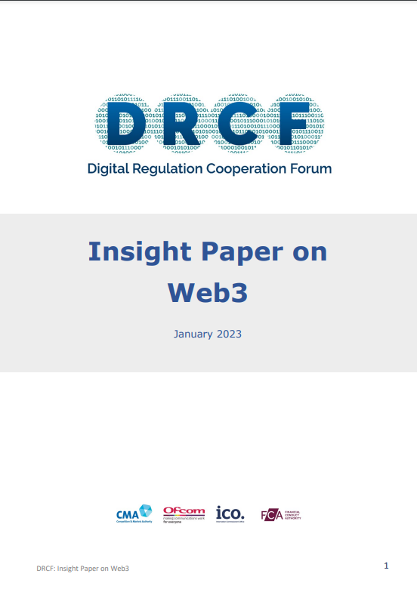
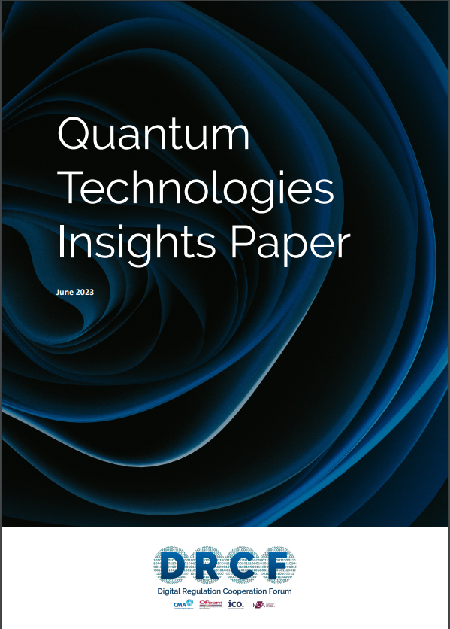

Key Publications
Insight Paper
on Web3
Quantum Technologies Insights Paper
Foresight Paper on Immersive Technologies
View the paper here
View the paper here
Coming soon
20

Slide 21


Key themes from the Quantum Insights paper
Notes:
I will now talk through some of the key themes from the regulatory considerations section of the paper

Slide 22



Looking ahead: Addressing potential future regulatory considerations
Transitioning to Quantum-safe systems
What is the role of the DRCF regulators in the transition to quantum safe systems?
Standards and specifications to complement regulation
How can the DRCF regulators engage with the development of quantum-specific standards and specifications?
Explainability, quantum computing, and artificial intelligence
How might the
integration of quantum technologies impact on explainability?
Notes:
The regulatory considerations of security and competition spoke to how our current regulations apply to quantum technologies, but given the medium time horizon of the technology, we also considered some potential future regulatory considerations as part of the paper.
We have three in the paper, and you can see them on this slide:
Transitioning to Quantum-safe systems
Standards and specifications to complement regulations
Explainability, quantum computing, and artificial intelligence
I will expand on two of these before handing back over to Elise.

Slide 23


FCA & World Economic Forum Quantum Security Work Programme

Slide 24
What are we seeking to achieve?
Generate insights and share knowledge on the risks arising from the emergence of quantum computing, and the roles and responsibilities of different stakeholders in the financial services ecosystem.
Inform future harmonisation in early regulatory thinking and approaches in post-quantum cybersecurity, ensuring organisations have clear expectations of the regulatory approaches in diverse jurisdictions and to mitigate international misalignment.
Enable a safe transition to post-quantum security by raising awareness of the risks and fostering ongoing collaboration between stakeholders towards shared, desired outcomes.

Slide 25





Overview of the Work Programme
2024
Nov
16th
July
5th
July
17th/21st
Sep
14th
Industry Roundtable
Convene industry to gather insights on adoption trends and challenges regarding post-quantum security
Output and Continued International Initiatives
Conference Call
Education Session
Regulatory Roundtable
Joint
Industry-Regulator Roundtable
This initial meeting to provide more detail on the work programme
An education session with leading academics to ensure a base-level understanding among regulators
Convene regulators to forge a path towards international collaboration on post-quantum security
An opportunity for industry players and regulators to collaborate on towards post—quantum security
Publish the final report and build on collaborative relationships to continue diving forward towards a secure transition to post quantum security
Sep
21st

Slide 26






Early Insights from the Roundtables
Actions
Risks
Regulatory fragmentation
Early misalignment in regulatory approaches
Regulation as a trigger
Building internal capabilities
Financial system will be as strong as its weakest link
Understanding regulatory gaps

Slide 27
What does the future hold?

Slide 28
Future Plans
In addition to the mentioned technologies, we are also focusing on:
We are expecting to explore more tokenisation use cases in asset management and support our policy colleagues
Futures of Digital Identity with the DRCF
Follow-up work on quantum computing, focused on the regulatory gaps
Work on Artificial Intelligence (AI) will continue, building on the recently published Feedback Statement
Technologies of interest
Quantum Technologies
DeFi:
Price Oracles & Maximal Extractable Value
Immersive Technologies Business Models
Futures & Foresight Pilot
Synthetic Data & Privacy Enhancing Technologies
Evolutions of Digital Identity
If you would like to provide input into our work programme, or have ideas on areas we should explore, please do not hesitate to reach out to emergingtech@fca.org.uk
28

Slide 29
Any Questions?

